Slide 1
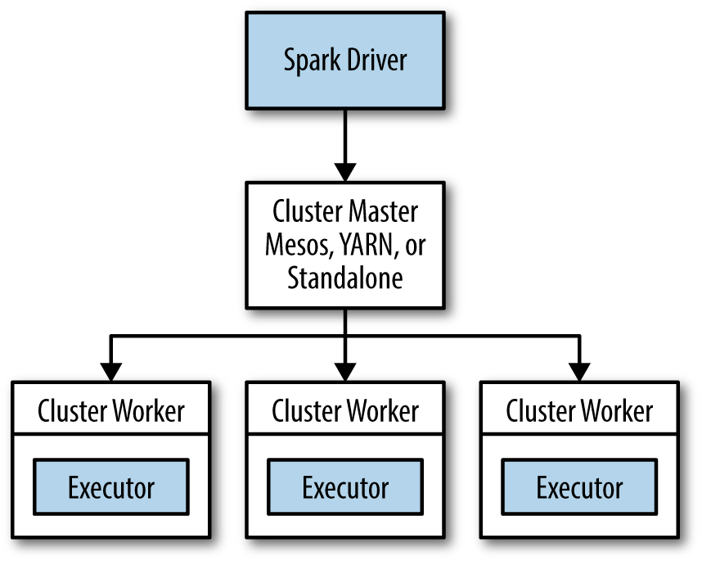
Overview
What is Spark?
Apache Spark is a cluster computing platform designed to be fast and general-purpose.

Slide 2
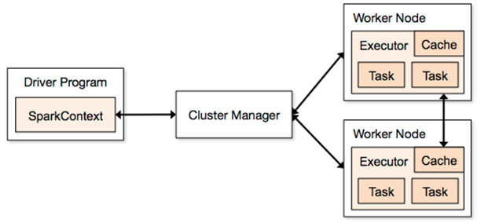
Spark Runtime Architecture

Slide 3
Spark Application
In Distributed Mode, Spark uses a master slave architecture with a single coordinator and many distributed workers.
The Central Coordinator is called the driver of the program. It communicates with potentially large number of distributed workers called Executors.
The Driver runs in its own Java Process and each executor is a separate Java Process. A driver and its executors are together terms as a Spark Application.
A Spark Application is launched on a cluster manager.
It has a built in-cluster manager called Standalone cluster manager.

Slide 4
Components of Spark
Driver : Master of the Spark application. It is the user code which has the main(), creates RDD’s and creates the SparkContext.
SparkContext : It represents the connection to a Spark Cluster, and can be used to create RDDs, accumulators and broadcast variables on that cluster.
Executors : (Workers)
Jobs :
Stages : Divided on the basis of shuffling
Tasks :
Difference between Jobs, Stages and tasks
Notes:
(https://stackoverflow.com/questions/42263270/what-is-the-concept-application-job-stage-and-task-in-spark)

Slide 5
Driver(Role)
Spawns the SparkContext
Has control over all the executors and assigns work to them.
Converts the logical DAG into physical execution plan with a set of stages
Negotiates resources with the cluster Manager
It create physical execution units referred to as tasks under each stage. Hence, declares the operations on the data using RDD transformations and actions.

Slide 6
Executor (Role)
Responsible for the execution of tasks.
Executors perform all the data processing.
Reads and writes data to the external sources.

Slide 7
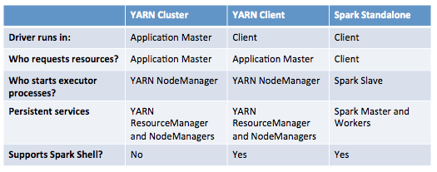
Spark On Yarn

Slide 8
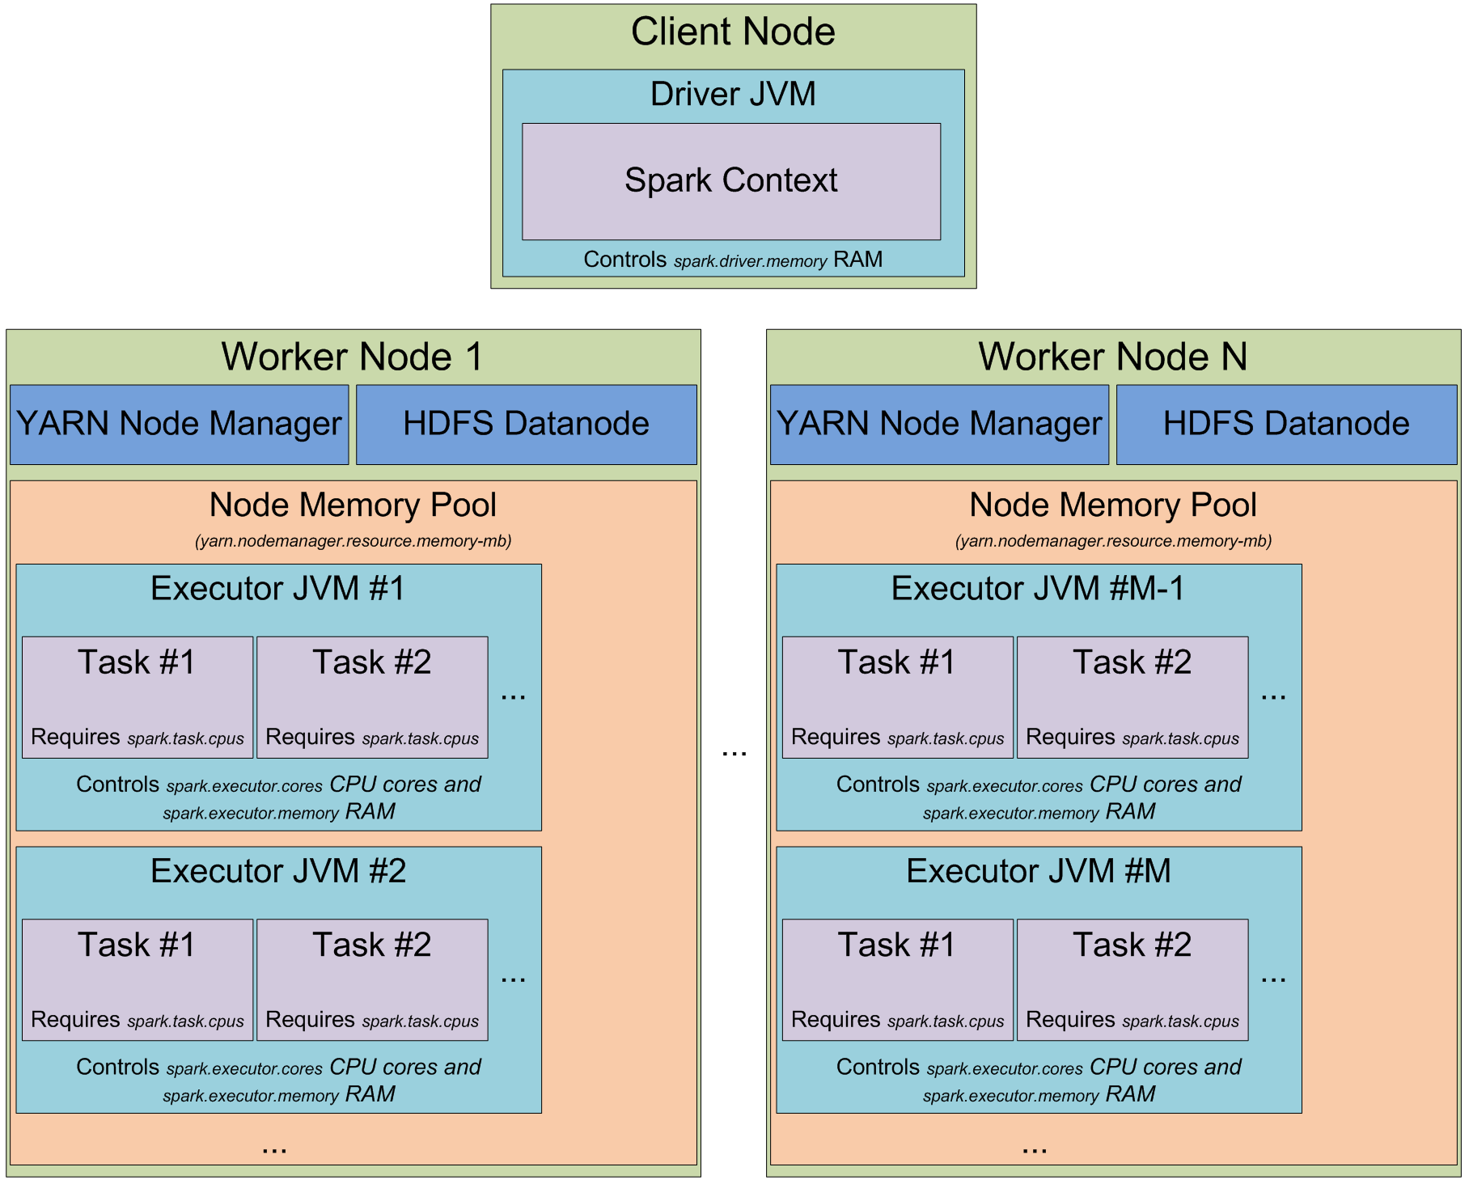
Details of Spark code execution

Slide 9
Resilient Distributed Dataset - Spark’s main programming abstraction.
Represent a collection of items distributed across many compute nodes that can be manipulated in parallel.
The ability to always recompute an RDD is actually why RDDs are called “resilient”.
Features :
Read Only
Immutable distributed collection of objects
Helpful in parallelizing (divided into multiple partitions)
Lazily computed
RDD

Slide 10
Transformations
Operations that returns a new RDD.
Examples :
Map
Filter
FlatMap
Group by
Reduce
Join

Slide 11
Actions
Operations that return a final value to the driver program or some external storage system.
Force the evaluation of transformations required for the RDD they were called on to actually produce output.
Examples :
Collect
Count
forEach
Save As Text File

Slide 12
Recalculation of RDD
If an RDD is reused, RDD will be recomputed.
We need to persist RDD (cache) so that RDD is not recomputed.

Slide 13
Assignment 1

Slide 14
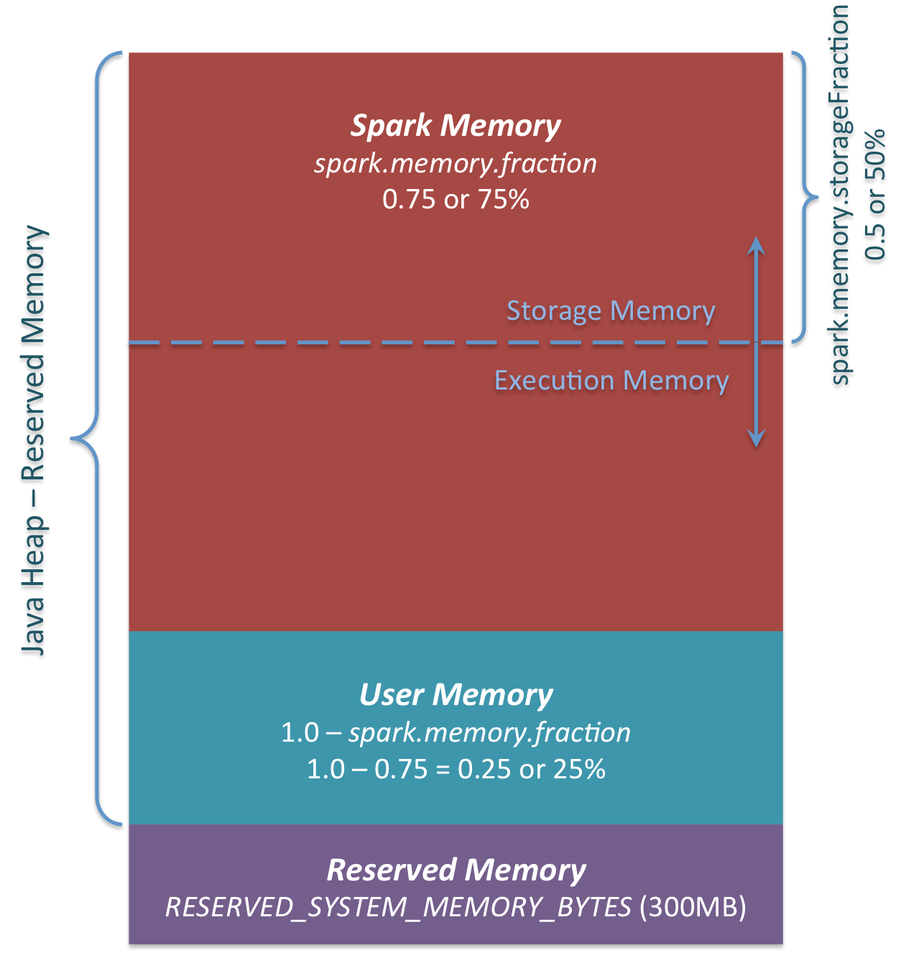
Memory Management of Spark 1.6 and above
Execution Memory
Storage memory-

Slide 15
Why is spark better than Map reduce?
Efficiently support more types of computations, including interactive queries and stream processing.
Ability to run computations in memory.
System is more efficient for applications which are running on disk as well
It supports higher level workloads like Machine Learning, SQL

Slide 16
